Slide 1

Probability Review

Slide 2
Probability Review
Events and Event spaces
Random variables
Joint probability distributions
Marginalization, conditioning, chain rule, Bayes Rule, law of total probability, etc.
Structural properties
Independence, conditional independence
Mean and Variance
The big picture
Examples

Slide 3
Sample space and Events
Ω : Sample Space, result of an experiment
If you toss a coin twice Ω = {ΗΗ,ΗΤ,ΤΗ,ΤΤ}
Event: a subset of Ω
First toss is head = {HH,HT}
S: event space, a set of events:
Closed under finite union and complements
Entails other binary operation: union, diff, etc.
Contains the empty event and Ω

Slide 4
Probability Measure
Defined over (Ω,S) s.t.
P(α) >= 0 for all α in S
P(Ω) = 1
If α, β are disjoint, then
P(α U β) = p(α) + p(β)
We can deduce other axioms from the above ones
Ex: P(α U β) for non-disjoint event
P(α U β) = p(α) + p(β) – p(α ∩ β)

Slide 5
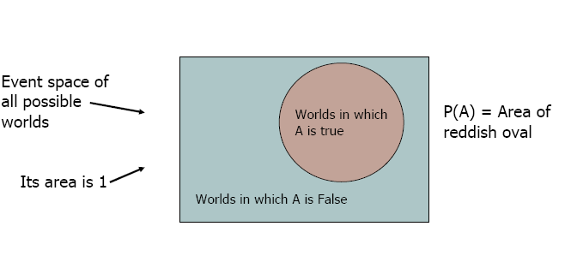
Visualization
We can go on and define conditional probability, using the above visualization

Slide 6
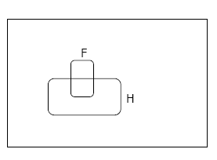
Conditional Probability
P(F|H) = Fraction of worlds in which H is true that also have F true

Slide 7
Rule of total probability
B₅
B₃
B₂
B₄
A
B₁
B₇
B₆

Slide 8
From Events to Random Variable
Almost all the semester we will be dealing with RV
Concise way of specifying attributes of outcomes
Modeling students (Grade and Intelligence):
Ω = all possible students
What are events
Grade_A = all students with grade A
Grade_B = all students with grade B
Intelligence_High = … with high intelligence
Very cumbersome
We need “functions” that maps from Ω to an attribute space.
P(G = A) = P({student ϵ Ω : G(student) = A})

Slide 9

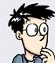


Random Variables
Ω
I:Intelligence
High
low
A
G:Grade
B
A+
P(I = high) = P( {all students whose intelligence is high})

Slide 10
Discrete Random Variables
Random variables (RVs) which may take on only a countable number of distinct values
E.g. the total number of tails X you get if you flip 100 coins
X is a RV with arity k if it can take on exactly one value out of {x₁, …, x_{k}}
E.g. the possible values that X can take on are 0, 1, 2, …, 100

Slide 11
Probability of Discrete RV
Probability mass function (pmf): P(X = x_{i})
Easy facts about pmf
Σ_{i} P(X = x_{i}) = 1
P(X = x_{i}∩X = x_{j}) = 0 if i ≠ j
P(X = x_{i} U X = x_{j}) = P(X = x_{i}) + P(X = x_{j}) if i ≠ j
P(X = x₁ U X = x₂ U … U X = x_{k}) = 1

Slide 12
Common Distributions
Uniform X U[1, …, N]
X takes values 1, 2, … N
P(X = i) = 1/N
E.g. picking balls of different colors from a box
Binomial X Bin(n, p)
X takes values 0, 1, …, n
E.g. coin flips

Slide 13
Continuous Random Variables
Probability density function (pdf) instead of probability mass function (pmf)
A pdf is any function f(x) that describes the probability density in terms of the input variable x.

Slide 14
Probability of Continuous RV
Properties of pdf
Actual probability can be obtained by taking the integral of pdf
E.g. the probability of X being between 0 and 1 is

Slide 15
Cumulative Distribution Function
F_{X}(v) = P(X ≤ v)
Discrete RVs
F_{X}(v) = Σ_{vi} P(X = v_{i})
Continuous RVs

Slide 16
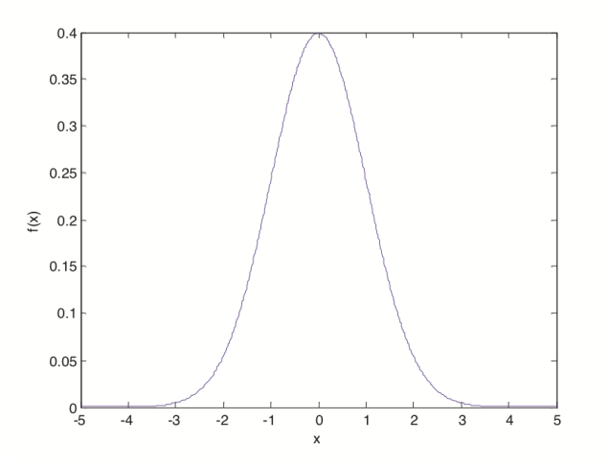
Common Distributions
Normal X N(μ, σ²)
E.g. the height of the entire population

Slide 17
Multivariate Normal
Generalization to higher dimensions of the one-dimensional normal
Covariance matrix
.
Mean

Slide 18
Probability Review
Events and Event spaces
Random variables
Joint probability distributions
Marginalization, conditioning, chain rule, Bayes Rule, law of total probability, etc.
Structural properties
Independence, conditional independence
Mean and Variance
The big picture
Examples

Slide 19
Joint Probability Distribution
Random variables encodes attributes
Not all possible combination of attributes are equally likely
Joint probability distributions quantify this
P( X= x, Y= y) = P(x, y)
Generalizes to N-RVs

Slide 20
Chain Rule
Always true
P(x, y, z) = p(x) p(y|x) p(z|x, y)
= p(z) p(y|z) p(x|y, z)
=…

Slide 21
Conditional Probability
events
But we will always write it this way:

Slide 22
Marginalization
We know p(X, Y), what is P(X=x)?
We can use the low of total probability, why?
B₅
B₃
B₂
B₄
A
B₁
B₇
B₆

Slide 23
Marginalization Cont.
Another example

Slide 24
Bayes Rule
We know that P(rain) = 0.5
If we also know that the grass is wet, then how this affects our belief about whether it rains or not?

Slide 25
Bayes Rule cont.
You can condition on more variables

Slide 26
Probability Review
Events and Event spaces
Random variables
Joint probability distributions
Marginalization, conditioning, chain rule, Bayes Rule, law of total probability, etc.
Structural properties
Independence, conditional independence
Mean and Variance
The big picture
Examples

Slide 27
Independence
X is independent of Y means that knowing Y does not change our belief about X.
P(X|Y=y) = P(X)
P(X=x, Y=y) = P(X=x) P(Y=y)
The above should hold for all x, y
It is symmetric and written as X ⊥ Y

Slide 28
Independence
X₁, …, X_{n} are independent if and only if
If X₁, …, X_{n} are independent and identically distributed we say they are iid (or that they are a random sample) and we write
X₁, …, X_{n} ∼ P

Slide 29
CI: Conditional Independence
RV are rarely independent but we can still leverage local structural properties like Conditional Independence.
X ⊥ Y | Z if once Z is observed, knowing the value of Y does not change our belief about X
P(rain ⊥ sprinkler’s on | cloudy)
P(rain ⊥ sprinkler’s on | wet grass)

Slide 30
Conditional Independence
P(X=x | Z=z, Y=y) = P(X=x | Z=z)
P(Y=y | Z=z, X=x) = P(Y=y | Z=z)
P(X=x, Y=y | Z=z) = P(X=x| Z=z) P(Y=y| Z=z)
We call these factors : very useful concept !!

Slide 31
Probability Review
Events and Event spaces
Random variables
Joint probability distributions
Marginalization, conditioning, chain rule, Bayes Rule, law of total probability, etc.
Structural properties
Independence, conditional independence
Mean and Variance
The big picture
Examples

Slide 32
Mean and Variance
Mean (Expectation):
Discrete RVs:
Continuous RVs:

Slide 33
Mean and Variance
Variance:
Discrete RVs:
Continuous RVs:
Covariance:
Covariance:

Slide 34
Mean and Variance
Correlation:

Slide 35
Properties
Mean
If X and Y are independent,
Variance
If X and Y are independent,

Slide 36
Some more properties
The conditional expectation of Y given X when the value of X = x is:
The Law of Total Expectation or Law of Iterated Expectation:

Slide 37
Some more properties
The law of Total Variance:

Slide 38
Probability Review
Events and Event spaces
Random variables
Joint probability distributions
Marginalization, conditioning, chain rule, Bayes Rule, law of total probability, etc.
Structural properties
Independence, conditional independence
Mean and Variance
The big picture
Examples

Slide 39
The Big Picture
Probability
Model
Data
Estimation/learning

Slide 40
Statistical Inference
Given observations from a model
What (conditional) independence assumptions hold?
Structure learning
If you know the family of the model (ex, multinomial), What are the value of the parameters: MLE, Bayesian estimation.
Parameter learning

Slide 41
Probability Review
Events and Event spaces
Random variables
Joint probability distributions
Marginalization, conditioning, chain rule, Bayes Rule, law of total probability, etc.
Structural properties
Independence, conditional independence
Mean and Variance
The big picture
Examples

Slide 42
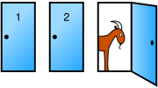
Monty Hall Problem
You're given the choice of three doors: Behind one door is a car; behind the others, goats.
You pick a door, say No. 1
The host, who knows what's behind the doors, opens another door, say No. 3, which has a goat.
Do you want to pick door No. 2 instead?

Slide 43

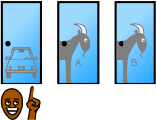


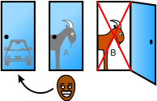
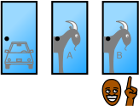
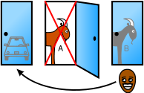
 |  | Host must reveal Goat B
 |  | Host must reveal Goat A
Host reveals Goat A or Host reveals Goat B

Slide 44
Monty Hall Problem: Bayes Rule
: the car is behind door i, i = 1, 2, 3
: the host opens door j after you pick door i

Slide 45
Monty Hall Problem: Bayes Rule cont.
WLOG, i=1, j=3

Slide 46
Monty Hall Problem: Bayes Rule cont.

Slide 47
Monty Hall Problem: Bayes Rule cont.
You should switch!

Slide 48
Information Theory
P(X) encodes our uncertainty about X
Some variables are more uncertain that others
How can we quantify this intuition?
Entropy: average number of bits required to encode X
P(X)
P(Y)
X
Y

Slide 49
Information Theory cont.
Entropy: average number of bits required to encode X
We can define conditional entropy similarly
i.e. once Y is known, we only need H(X,Y) – H(Y) bits
We can also define chain rule for entropies (not surprising)

Slide 50
Mutual Information: MI
Remember independence?
If X⊥Y then knowing Y won’t change our belief about X
Mutual information can help quantify this! (not the only way though)
MI:
“The amount of uncertainty in X which is removed by knowing Y”
Symmetric
I(X;Y) = 0 iff, X and Y are independent!

Slide 51
Chi Square Test for Independence (Example)
 | Republican | Democrat | Independent | Total
Male | 200 | 150 | 50 | 400
Female | 250 | 300 | 50 | 600
Total | 450 | 450 | 100 | 1000
State the hypotheses
H₀: Gender and voting preferences are independent. H_{a}: Gender and voting preferences are not independent
Choose significance level
Say, 0.05

Slide 52
Chi Square Test for Independence
 | Republican | Democrat | Independent | Total
Male | 200 | 150 | 50 | 400
Female | 250 | 300 | 50 | 600
Total | 450 | 450 | 100 | 1000
Analyze sample data
Degrees of freedom =
|g|-1 * |v|-1 = (2-1) * (3-1) = 2
Expected frequency count =
E_{g,v} = (n_{g} * n_{v}) / n
E_{m,r} = (400 * 450) / 1000 = 180000/1000 = 180 E_{m,d}= (400 * 450) / 1000 = 180000/1000 = 180 E_{m,i} = (400 * 100) / 1000 = 40000/1000 = 40 E_{f,r} = (600 * 450) / 1000 = 270000/1000 = 270 E_{f,d} = (600 * 450) / 1000 = 270000/1000 = 270 E_{f,i} = (600 * 100) / 1000 = 60000/1000 = 60

Slide 53
Chi Square Test for Independence
 | Republican | Democrat | Independent | Total
Male | 200 | 150 | 50 | 400
Female | 250 | 300 | 50 | 600
Total | 450 | 450 | 100 | 1000
Chi-square test statistic
Χ² = (200 - 180)²/180 + (150 - 180)²/180 + (50 - 40)²/40 +
(250 - 270)²/270 + (300 - 270)²/270 + (50 - 60)²/40
Χ² = 400/180 + 900/180 + 100/40 + 400/270 + 900/270 +
100/60
Χ² = 2.22 + 5.00 + 2.50 + 1.48 + 3.33 + 1.67 = 16.2

Slide 54
Chi Square Test for Independence
P-value
Probability of observing a sample statistic as extreme as the test statistic
P(X² ≥ 16.2) = 0.0003
Since P-value (0.0003) is less than the significance level (0.05), we cannot accept the null hypothesis
There is a relationship between gender and voting preference

Slide 55
THANK YOU
www.linkedin.com/in/ajantha-devi-vairamani
YouTube: @DemystifywithAjay

